Slide 1
Module 7 - 8
Material Design Guidelines

Slide 2
Introduction .
Material is a design system created by Google in 2014 to help teams build high-quality digital experiences for Android, iOS, Flutter, and the web.
Material Design is inspired by the physical world and its textures, including how they reflect light and cast shadows.
Material surfaces reimaging the mediums of paper and ink.
Material Design is created to bring a unified user experience across various devices, platforms, and input methods.
Material Design ensured that, regardless of how users were accessing their products, they would have a consistent user experience.
The Material Design specification includes guidelines for everything: typography, grids, space, scale, color, and imagery.
But Material Design just explain designers how to make things look.
It enables designers to create intentional designs with hierarchy, meaning, and focus in their end result.

Slide 3
Material design principal
Material Is a Metaphor
Think of Material Design as the digitization of the physical world.
So, rather than ask visitors and users to enter a digital experience that feels unnatural to them, Material Design applies the basic principles of our physical environment to apps and websites.
Take, for instance, the idea of cause-and-effect. When someone does a certain action, they expect a predictable outcome.

Slide 4
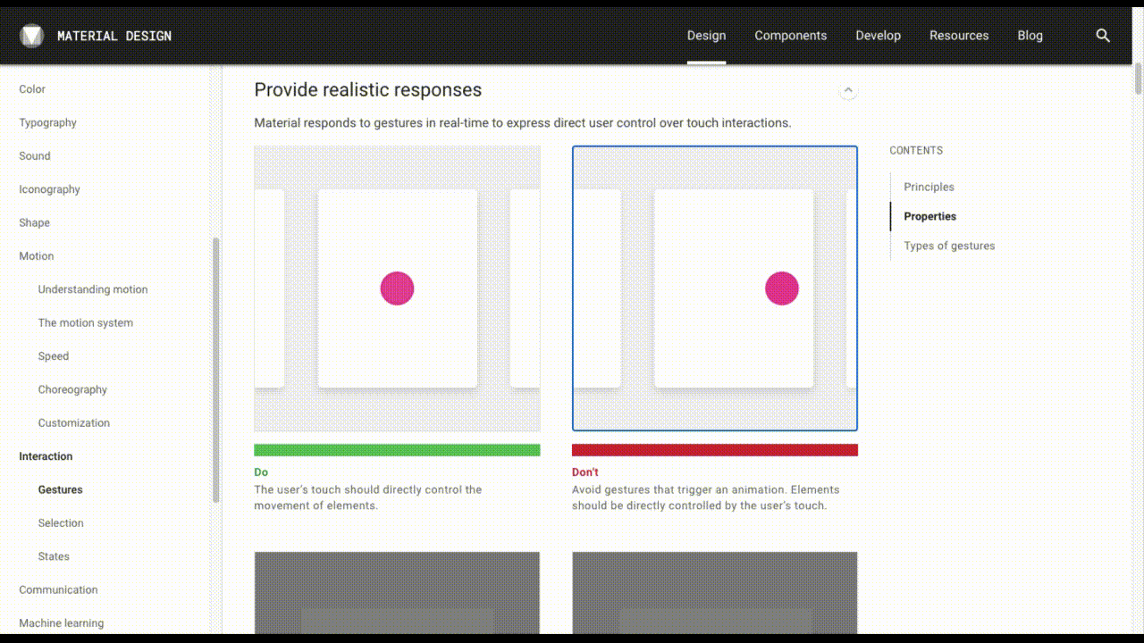

Slide 5
Explanation of motion image
Both interfaces have a horizontal scroller.
The one on the left only moves as the user clicks and drags the content. This is how it works in the real world.
The one on the right, however, has a click-activated scrolling animation. Our real-world objects don’t move this way.
By imbuing UIs with these kinds of physical properties, users can rely on their intuition and natural actions to engage with websites and apps.

Slide 6
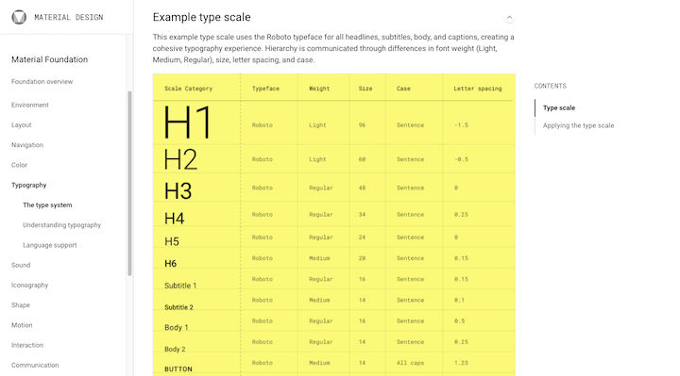
Principle #2: Bold, Graphic, Intentional
Make designs bold so users notice hierarchy instantly and can focus and draw appropriate meanings.
Excellent color and whitespace use, strong imagery and large typography across the screen help users become immersed in the experience.
Design to prompt users to act, and show functionality by emphasizing icons and surfaces as cues.

Slide 7
Make messages with motion
Put users in control by showing changes resulting directly from their actions.
Make animations play out in a single environment/stage, in continuous flowing movements.
Ensure responses are clear, but subtle: no unpredictable movements.

